Slide 1
Intermediate Excel – If Statements

Slide 2
IF Statements
IF function performs a logical test which is either true or false.
If something is true, one thing happens.
If something is false, another thing happens.
Another way of saying this:
The If statement will do a logical compare and based on the result, put in one answer if true and another if false.

Slide 3
IF Statement
The IF statement will do a logical compare and based on the result, put in one answer if true and another if false.
Start your IF statement with an =IF(
The syntax for the IF function is:
IF(condition, [value_if_true], [value_if_false])
condition is the value that you want to test.
value_if_true. It is the value that is returned if condition evaluates to TRUE.
value_if_false. It is the value that is returned if condition evaluates to FALSE. If there is no FALSE value, the result in the space would be empty. The FALSE value is optional.

Slide 4
Arguments of an IF Statement
IF function first performs a logical test which is either true or false
If the test result is true then IF function returns one value and if the test result is false then IF function returns another value
The IF function has three arguments separated by commas:
IF ( ____, ___, ___ )
1st argument: A logical test or condition that is true or false
2nd argument: value to be returned if the condition is true
3rd argument: value to be returned if the condition is false
= IF(E1>G6,E2,G2)
logical_test
value_to_be_returned_if_false
Value_to_be_returned_if_true
Notes:
The IF function enables a worksheet to display different results depending on a logical condition. For example, the IF function could be used to evaluate whether an employee has met a sales quota and display a bonus of either $500 or $0. The IF function has three arguments including the logical test, result if the condition is true, and result if the condition is false.

Slide 5
Logical Tests
The logical test is a comparison between two values stored in two cells
(e.g. Is A3 greater than B5)
The result of the test is either True or False
The comparison is made using logical operators
= Equal to (Is A3 equal to B5)
<> Not equal to (Is A3 not equal to B5)
< Less than (Is A3 less than B5)
> Greater than (Is A3 greater than B5)
<= Less than or equal to (Is A3 less than or equal to B5)
>= Greater than or equal to (Is A3 greater than or equal to B5)
Notes:
The logical test is typically a binary expression, meaning that it requires a comparison between two variables, such as the values stored in cells A2 and A3.
See Table 2.3 for a list of logical operators.

Slide 6
Wildcard Characters in Microsoft Office Source: Weverka, Peter, Microsoft Office 2019, 2019
Character | Description | Examples
? | A single character | B?t finds bat, bet, bit, and but
# | A single numeric digit | 9411# finds 94111, 94112, 94113, and so on.
* | Any group of consecutive characters | t*o finds to, two, and tattoo.
[xyz] | Any character in the brackets | t[aio]pper finds tapper, tipper, and topper, but not tupper.
[!xy] | Any character not in the brackets | P[!io]t finds pat and pet, but not pit and pot.
x-z | Any character in a range of characters | [1-4]000 finds 1000, 2000, 3000, and 4000, but not 5000. The range must be in ascending order.

Slide 7
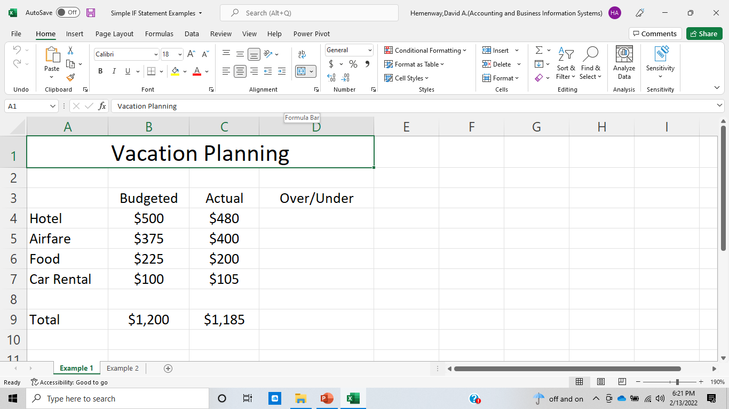
Get “Simple IF Statement Examples”

Slide 8
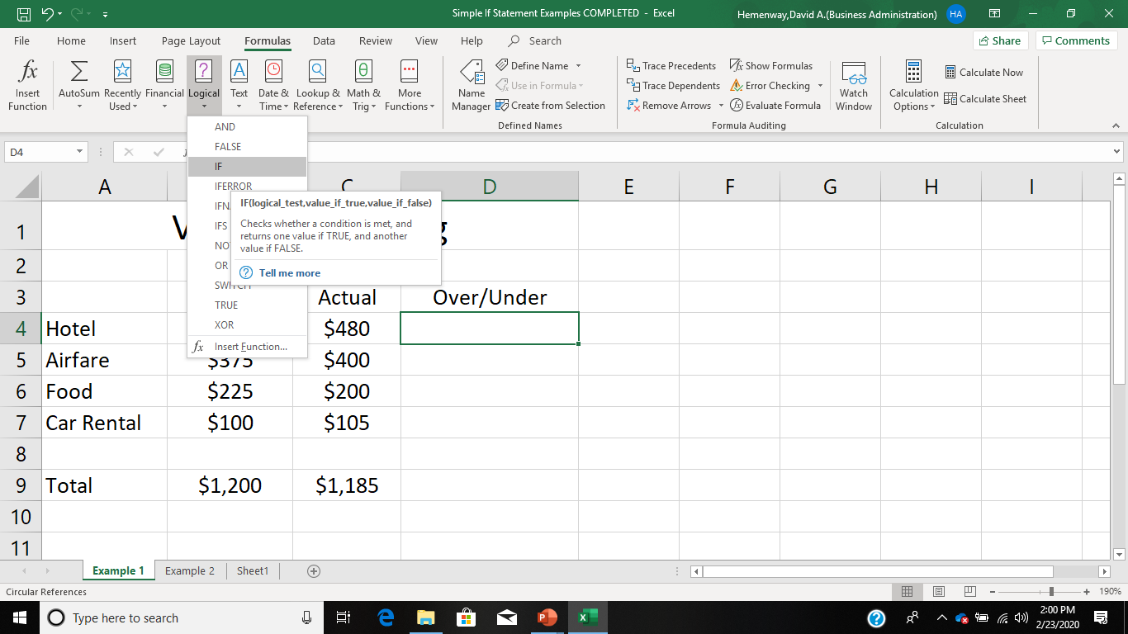

Slide 9
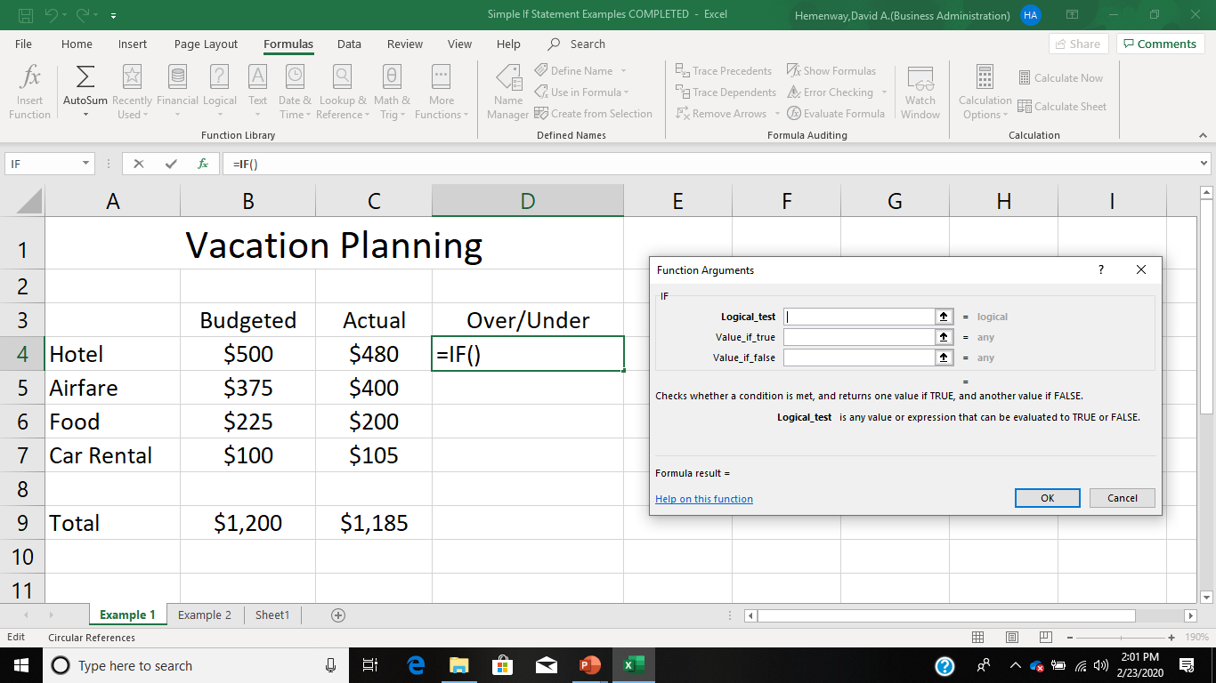

Slide 10
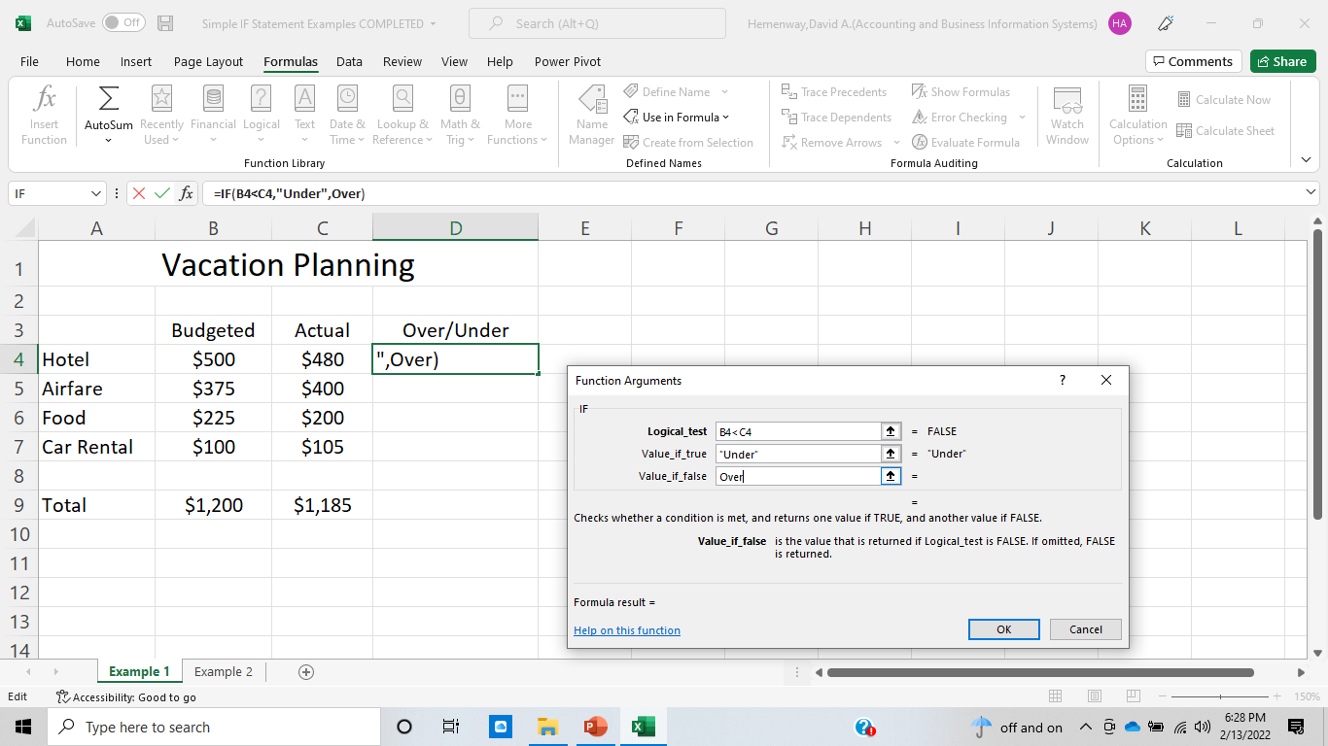

Slide 11
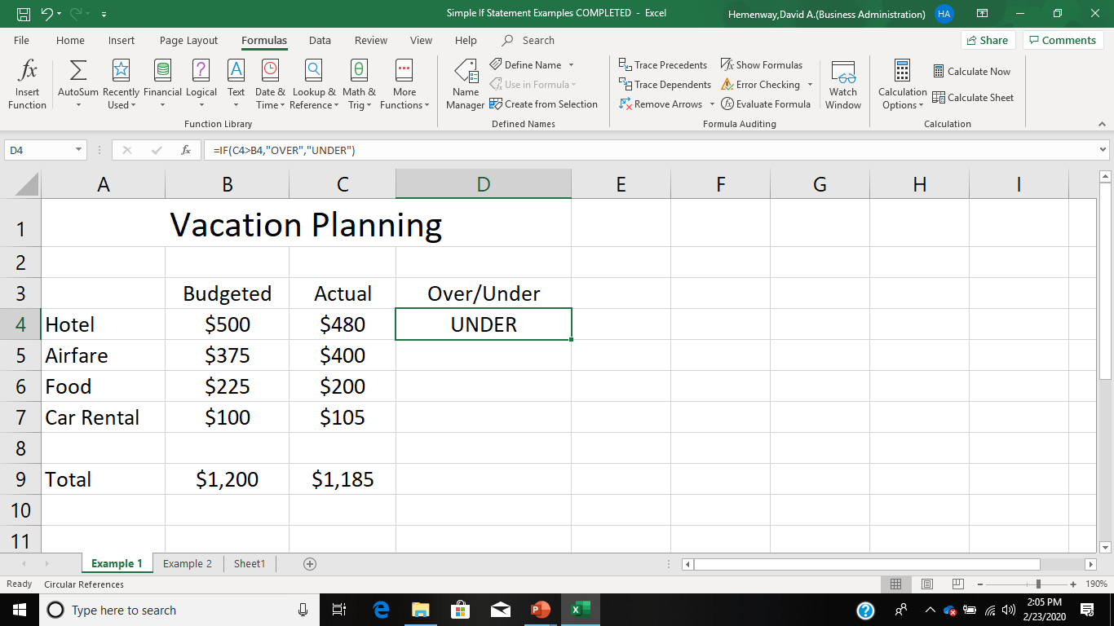

Slide 12
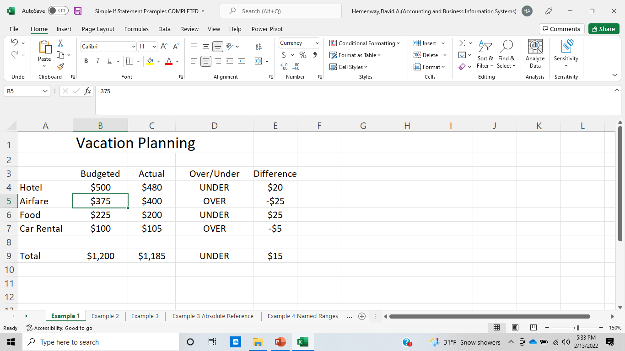

Slide 13
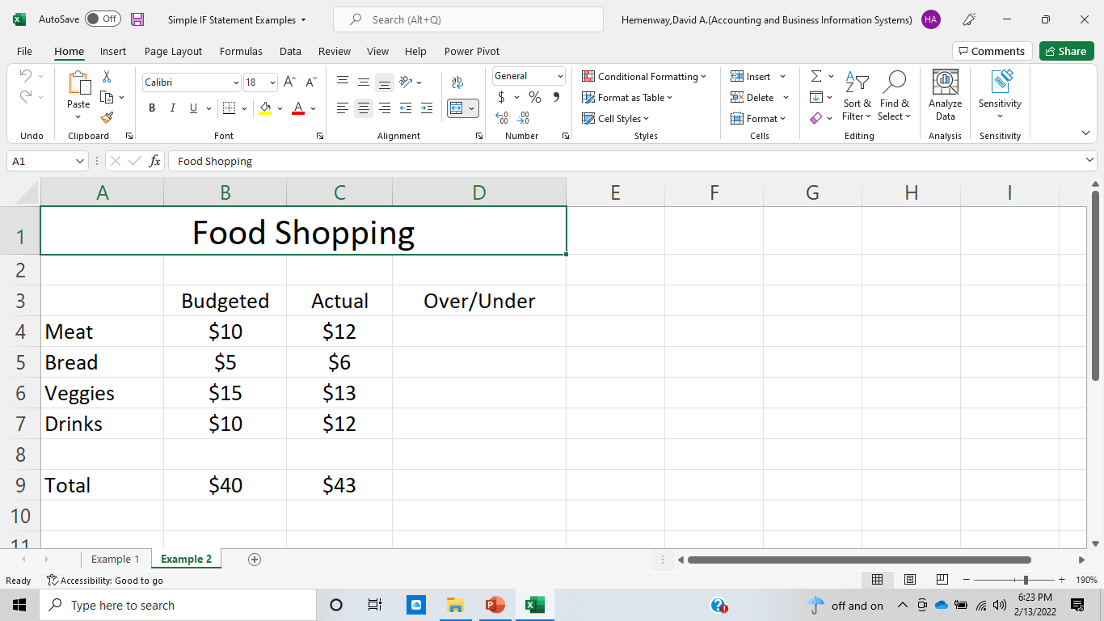
Second Simple Example – Food Shopping

Slide 14
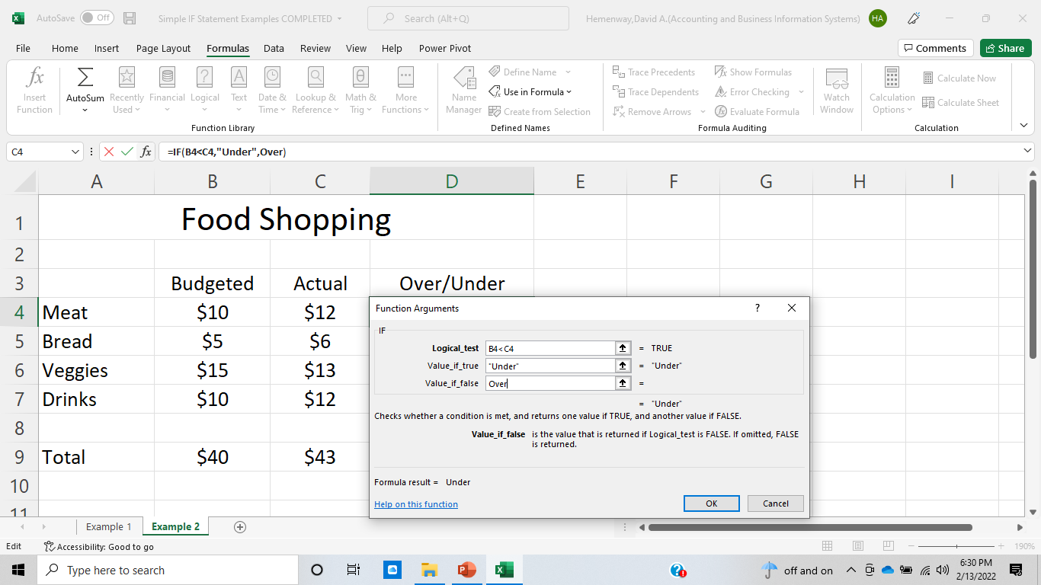

Slide 15
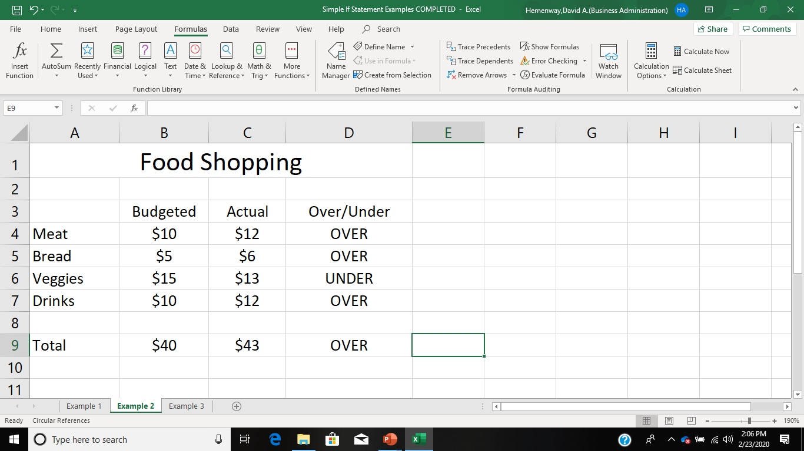

Slide 16
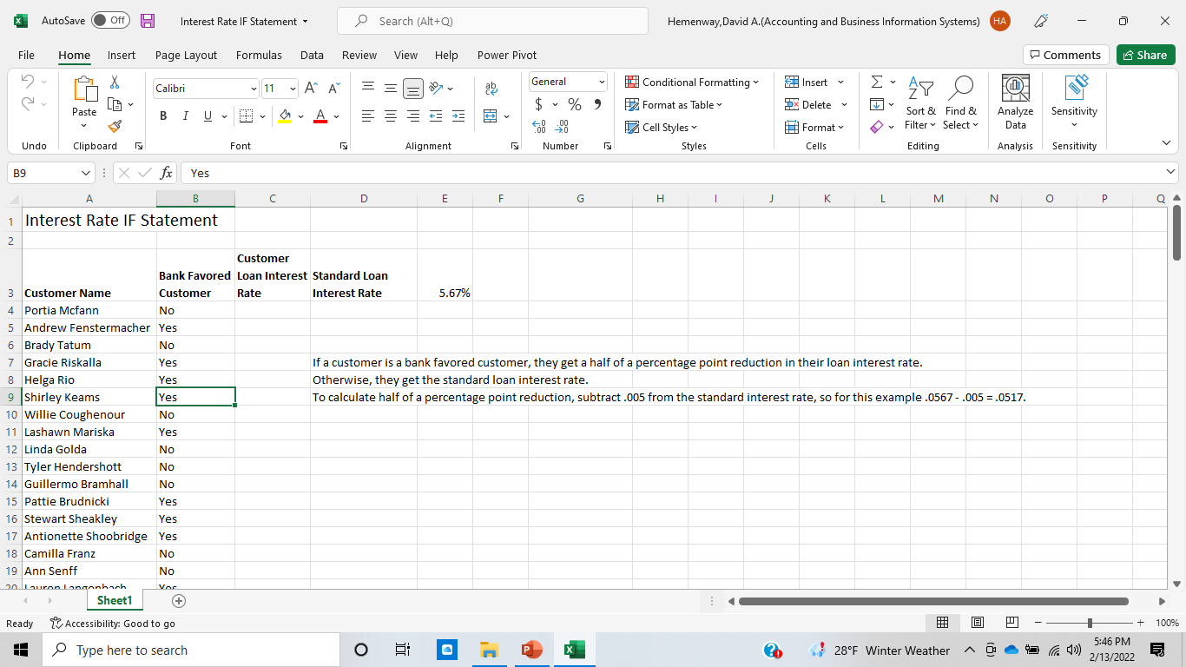
Interest Rate IF Statement

Slide 17
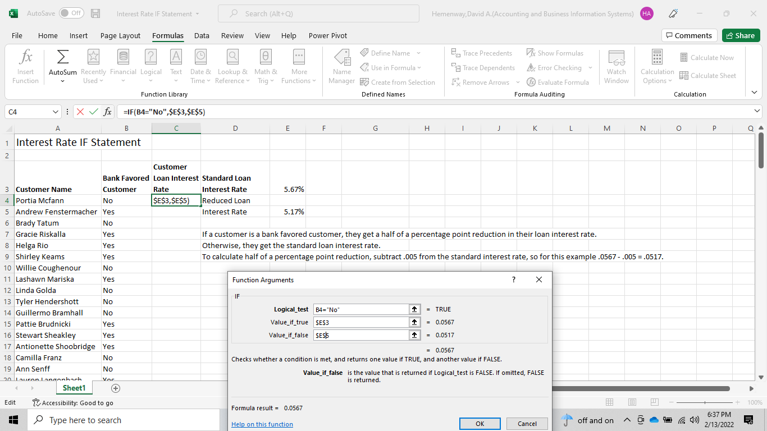
Interest Rate IF Statement

Slide 18
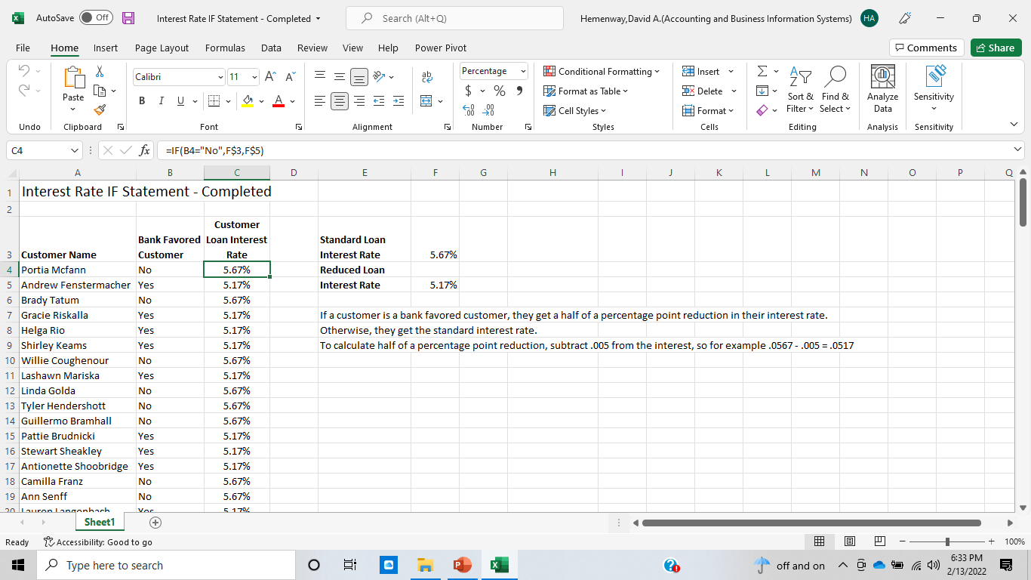
Interest Rate IF Statement

Slide 19
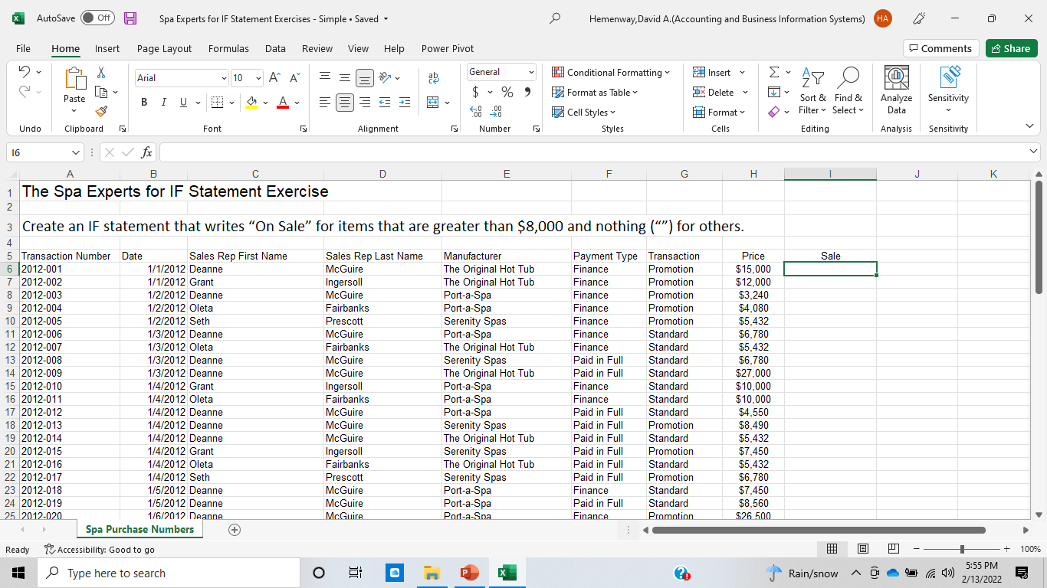
Open your Spa Experts for IF Statements - Simple

Slide 20
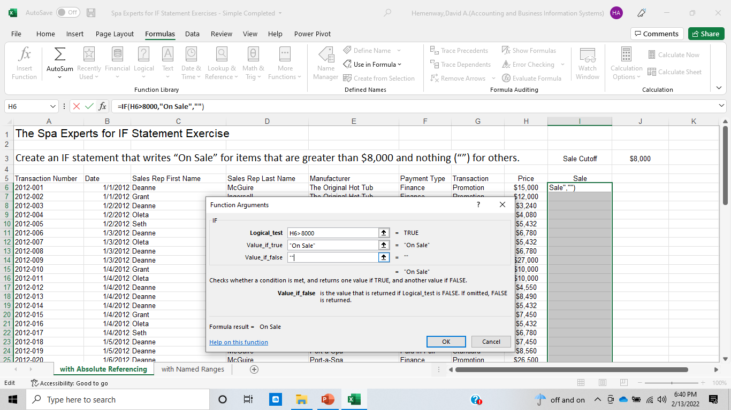

Slide 21
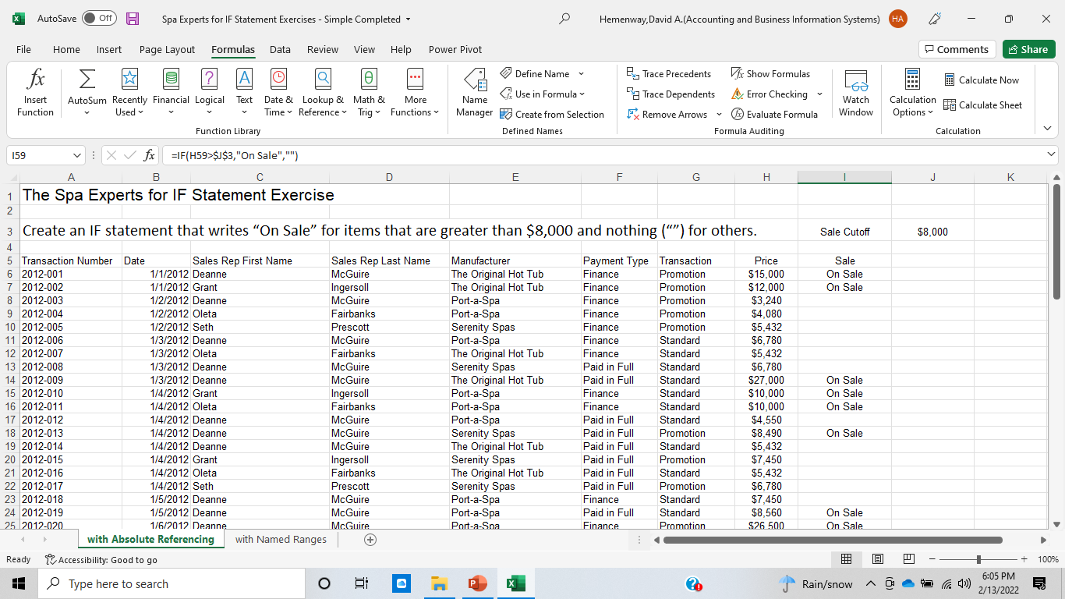
Using Spa Experts add a new column Sale. Create an IF statement that writes “On Sale” for items that are greater than $8,000 and nothing (“”) for others.

Slide 22
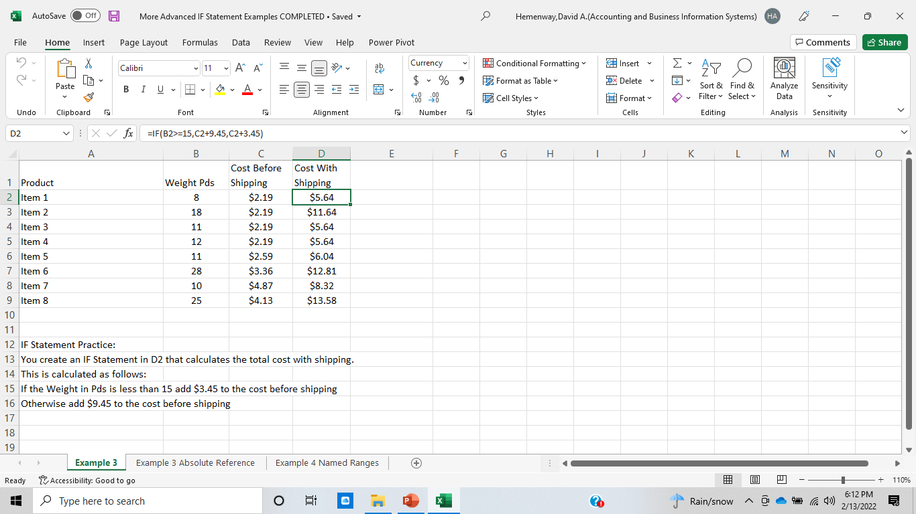
Complete More Advanced IF Statement Examples

Slide 23
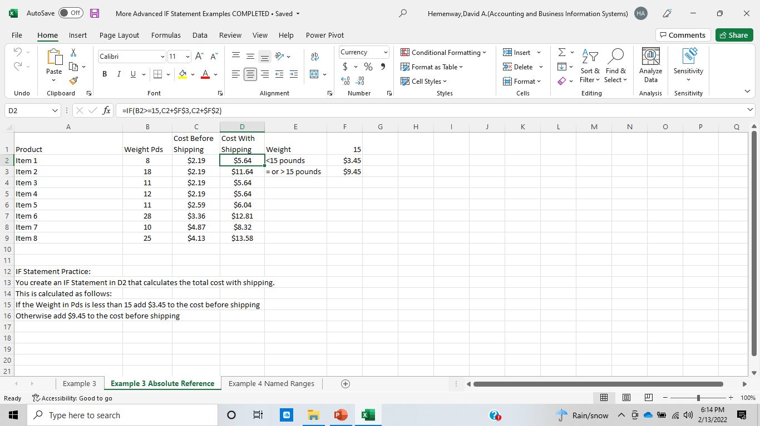
Complete More Advanced IF Statements with Absolute Referencing

Slide 24

Complete More Advanced IF Statements with Named Ranges

Slide 25
Arguments of an IF function
The value to be returned if the condition is true or false can be any of the following
cell reference (e.g. A7)
text/message within quotes (e.g. “Pass” or “Fail” or “Paid” or “Not paid”)
formula (e.g., =B6-B3)
function e.g. IF(C1>A5,MIN(D1:D4),MAX(D1:D4))
Compute the MIN function if C1 is greater than A5
Compute the MAX function if C1 is not less than A5
Note: When one function is embedded as an argument to another function, it is called a nested function.
Notes:
The IF function enables a worksheet to display different results depending on a logical condition. For example, the IF function could be used to evaluate whether an employee has met a sales quota and display a bonus of either $500 or $0. The IF function has three arguments including the logical test, result if the condition is true, and result if the condition is false.

